Slide 1

Design and Implementation of a Database Management System for Microfinance Loan and Repayment Management System
DBMS COURSE PROJECT
STUDENT NAME
[Student Name]
ROLL NUMBER
[Roll Number]
PROGRAM
Presentation III – Implementation & Working Prototype
B.Tech CSE – AIML
UNIVERSITY
Woxsen University
MENTOR
[Mentor Name]
MySQL 8.0 | Python | Flask | HTML + CSS
Notes:
Good morning everyone. My name is [your name], and this is Presentation III of my DBMS course project. My project is a database management system for microfinance loan and repayment management. In Presentation I and II we covered the problem and the design. Today I will focus on the implementation, so I will show the working prototype, how it connects to MySQL, and the testing results.

Slide 2






Project Implementation Overview
User
Web Interface
Flask Application
MySQL Connector
MySQL Database
Tables
Browser
HTML + CSS
Python routes
mysql.connector
microfinance_db
6 tables
TECHNOLOGY AT EACH LAYER
FRONT END
BACKEND
DATABASE
CONNECTIVITY
HTML + CSS
Python Flask
MySQL
mysql-connector-python
Registration form and client records table
Routes receive requests and run the SQL
Stores all data in microfinance_db
Sends queries and commits changes
Notes:
This slide shows how the design from the earlier presentations became a working prototype. The user opens a web page in the browser. The page is built with HTML and CSS. When the user does something, the request goes to a Flask application written in Python. Flask uses mysql-connector-python to talk to the MySQL database, which is called microfinance_db, and the data is stored in the tables. So there are four simple layers: front end, backend, connectivity and database.

Slide 3






Database Implementation
Used in UI
branch
loan_officer
client
DATABASE NAME
Branch locations: Hyderabad, Vijayawada, Warangal
Loan officers assigned to branches
Registered clients: name, contact, ID number
microfinance_db
MySQL 8.0
Sample data loaded: branches in Hyderabad, Vijayawada and Warangal, plus officers, clients, loans, repayments and transaction logs.
loan
repayment
transaction_log
Loans issued to clients
Repayment records for loans
Transaction records linked to repayments
Notes:
This is the database I actually implemented in MySQL. It is called microfinance_db and has six tables: branch, loan_officer, client, loan, repayment and transaction_log. Branch stores the branch locations, which are Hyderabad, Vijayawada and Warangal. Loan officers belong to branches and manage clients. Client stores the borrowers. Loan stores the loans given to clients, and repayment stores the repayments made against loans. Transaction_log keeps the transaction records. I have already loaded sample data into all of these tables. The client table is highlighted because the web prototype currently works on that table.

Slide 4

User Interface – Working Prototype
1
System header
Microfinance Loan & Repayment Management System
2
Database & system status
Database shows MySQL; system shows Connected
3
Total Clients card
Shows the number of clients in the database
[INSERT SCREENSHOT OF MAIN UI HERE]
Replace with your screenshot
4
Register New Client form
Client Name, Contact Number, ID Number, + Add Client
5
Client records table
Rows fetched from MySQL and displayed
6
Delete buttons
One button per client row
Notes:
This is the web interface I built. At the top there is the header with the system name and the subtitle, Database Management System Prototype. Then there are status cards: Total Clients, Database showing MySQL, and System showing Connected. Below that is the Register New Client form with three fields: client name, contact number and ID number, and the Add Client button. Under the form is the client records table, which shows the data from MySQL, and every row has a Delete button. Here I will show the screenshot of the actual running application.

Slide 5
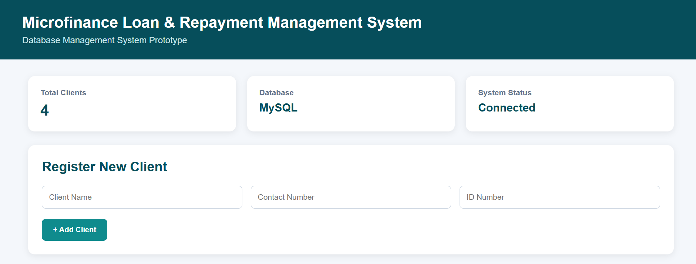
INSERT Operation – Add Client
1
User fills Name, Contact Number, ID Number
SQL
-- Generate the next client ID
SELECT COALESCE(MAX(client_id), 1000) + 1 FROM client;
-- Insert the new client
INSERT INTO client
(client_id, officer_id, name, contact, id_no)
VALUES (%s, %s, %s, %s, %s);
2
Clicks + Add Client
3
Flask receives form data (/add_client)
4
Next client ID is generated
5
INSERT query is executed
6
connection.commit()
7
New client appears in the UI
8
Record is stored in MySQL
Register New Client form: Client Name, Contact Number, ID Number and + Add Client
Notes:
This slide explains the INSERT operation step by step. The user types the client name, contact number and ID number and clicks Add Client. Flask receives this form data on the add_client route. First it finds the next client ID by taking the current maximum client ID and adding one, and if the table is empty it starts from 1001. Then it runs the INSERT query with the values from the form. After that, connection.commit() saves the change permanently in MySQL. The page then reloads and the new client appears in the table. The screenshot shows the Register New Client form where I enter these details.

Slide 6


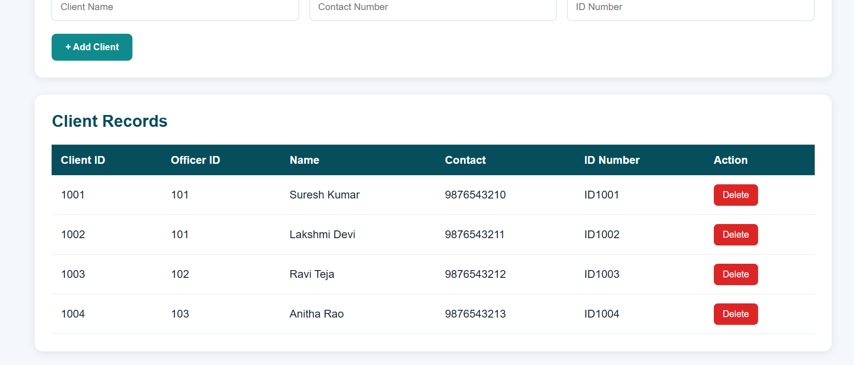
VIEW & DELETE Operations
VIEW – Read Records
DELETE – Remove a Record
Flask executes a SELECT query and retrieves the client records from MySQL. The records are displayed in the client table of the web interface.
1
User clicks Delete
2
Flask receives client_id
3
DELETE query executes
4
connection.commit()
5
Record removed from UI and MySQL
SQL
DELETE FROM client
WHERE client_id = %s;
Client Records table fetched from MySQL, with a Delete button on every row
Route: /delete_client/<client_id>
Notes:
This slide covers the VIEW and DELETE operations. For VIEW, when the page loads, Flask runs a SELECT query on the client table, gets all the records from MySQL and shows them in the Client Records table, as you can see in the screenshot. For DELETE, when I click the Delete button next to a client, Flask receives that client's ID through the delete_client route. It runs a DELETE query for that ID, then calls connection.commit() to save the change. The record disappears from the page and is also removed from MySQL. I will confirm this in the MySQL output on the next slide.

Slide 7
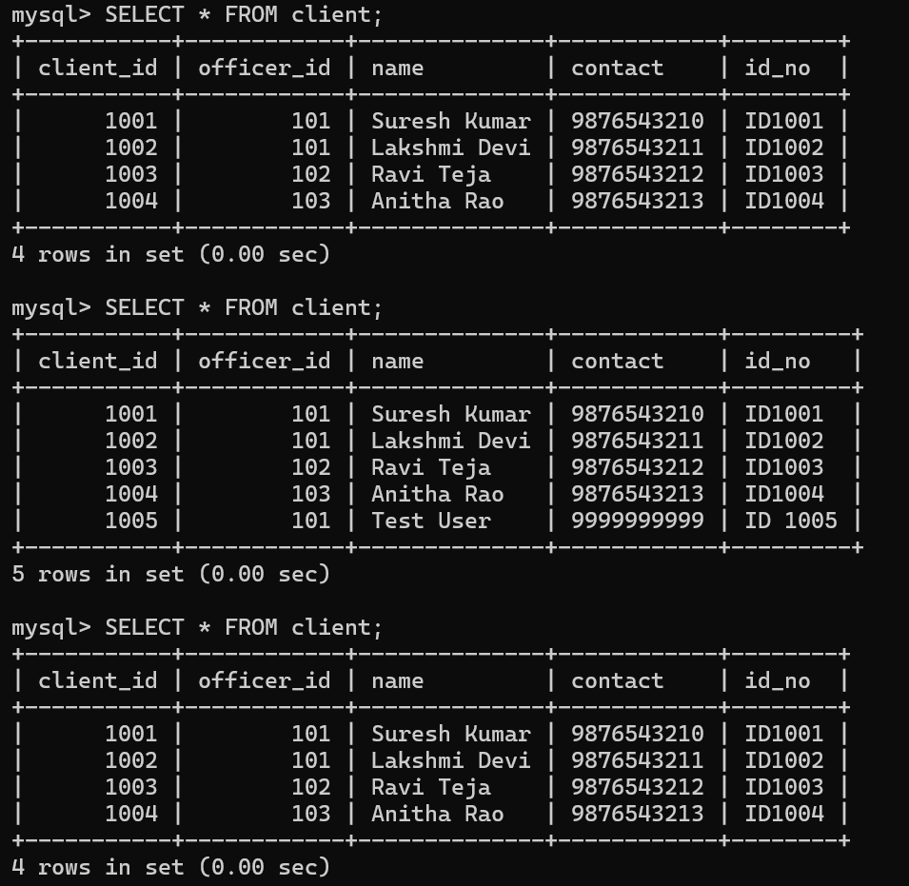

Testing & Results
# | Test Case | Expected Result | Result
1 | View existing clients | Existing MySQL records displayed in the UI | PASS
2 | Add new client | New client inserted into the database and displayed in the UI | PASS
3 | Delete client | Client removed from the UI and the database | PASS
4 | Database verification | SQL SELECT reflects the UI changes | PASS
Tested by performing actual INSERT and DELETE operations through the UI and verifying the changes with MySQL SELECT queries.
SELECT * FROM client; shows 4 rows, then 5 rows after INSERT (ID 1005), then 4 rows after DELETE
Notes:
This slide shows the testing. I tested four cases. First, viewing existing clients: the records stored in MySQL were displayed correctly. Second, adding a new client: the client was inserted into the database and also appeared in the UI. Third, deleting a client: it disappeared from the UI and was removed from the database. Fourth, database verification: I ran SELECT star from client in MySQL and the output matched the changes I made in the interface. The screenshot on the right shows it. The first result has 4 clients, the second has 5 after I added a test client with ID 1005, and the third is back to 4 after I deleted it. All four tests passed.

Slide 8
Conclusion
A working DBMS prototype has been successfully implemented.
The MySQL database is connected to a Flask-based web interface.
Client records can be viewed, inserted and deleted through the UI.
Database changes are reflected in real time after transactions are committed.
The prototype demonstrates successful integration between frontend, backend and database.
Notes:
To conclude, I have successfully built a working DBMS prototype. The MySQL database is connected to a Flask web interface, and I can view, add and delete client records from the browser. Every change is saved in MySQL after the commit, and I verified this using SELECT queries. This shows that the front end, backend and database work together as one system. Thank you, I am happy to take any questions.

